Slide 1
CGB1201 – JAVA PROGRAMMING
Department of Artificial Intelligence and Data Science
Academic Year: 2024 – 2025 (Odd Semester)
Register Number : 2303811724322122
Name : Vimalshree M
Year : II
Semester : III
Section : B
Date : 03/12/24

Slide 2
Title of the Project
DAILY TASK SCHEDULER

Slide 3
Abstract
The "Daily Task Scheduler" is a Java-based application designed to streamline task management and enhance productivity.
This project offers a user-friendly interface for individuals to efficiently plan, organize, and track their daily activities.
The primary goal of the system is to allow users to create, update, and delete tasks, set deadlines, and prioritize tasks based on importance or urgency.

Slide 4
Introduction
The "Daily Task Scheduler" is a Java-based application developed to help individuals and organizations organize their daily routines and improve productivity. This project leverages the power of Java programming to create a reliable, intuitive, and user-centric tool that enables users to plan, track, and complete their tasks efficiently.
The Daily Task Scheduler is designed to address common challenges such as forgetting important tasks, managing multiple priorities, and staying organized in a busy schedule. Users can add, update, or delete tasks, assign priorities, and set reminders to ensure timely completion. The system provides an interactive graphical user interface (GUI) built with Swing or JavaFX, offering an engaging experience and ease of use.

Slide 5
Java Programming - Concepts Used
Event Handling In AWT
Layout Management In AWT

Slide 6
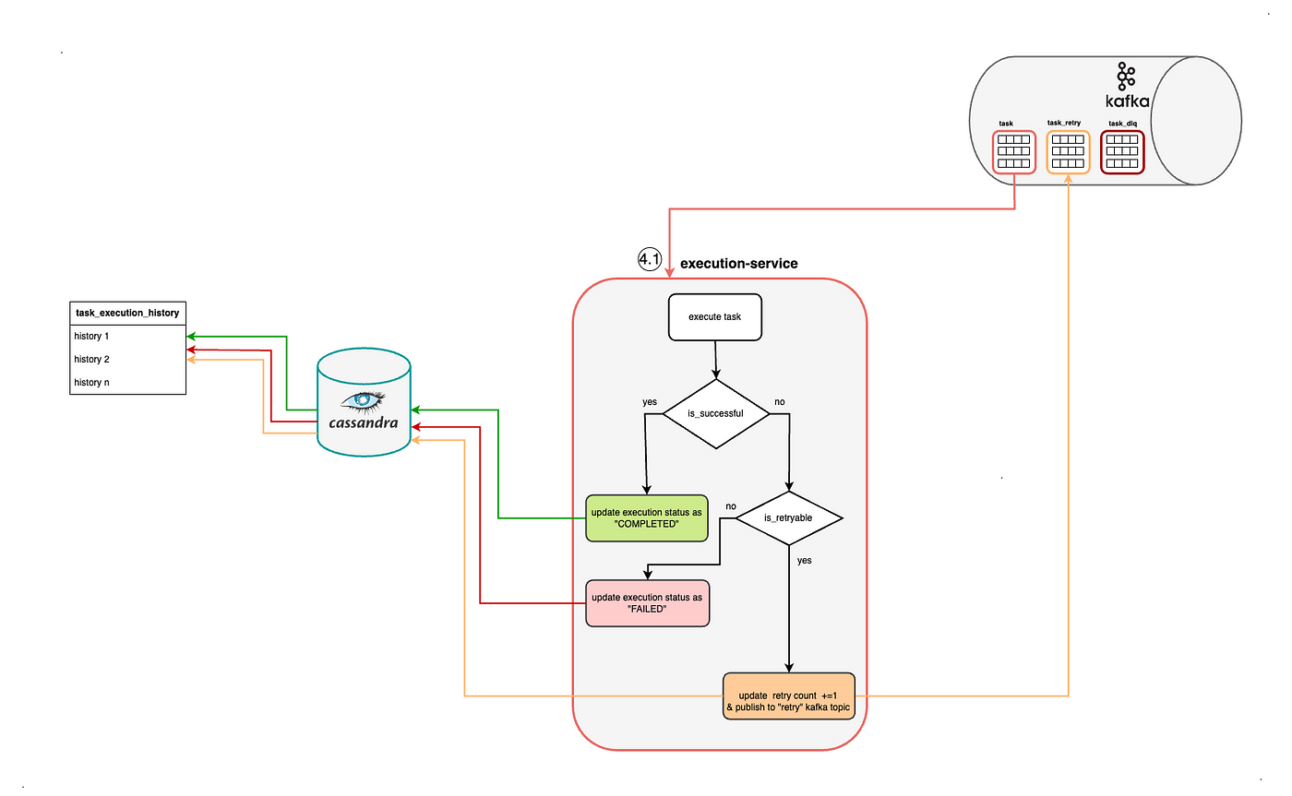
Proposed Architecture

Slide 7
Proposed Architecture - Description
1)Execution - Service: This is the core service that processes tasks. It includes the following steps:
Execute Task: The service attempts to execute the scheduled task.
Check Execution Success:
If the task is successful, its status is updated to "COMPLETED" in the database.
If unsuccessful, it checks whether the task is retryable.
Retryable Tasks:
For tasks that can be retried, the retry count is incremented, and the task is published to the "retry" Kafka topic for another attempt.
If a task is not retryable, the status is updated to "FAILED" in the database.
2)Cassandra Database:
Serves as the storage system for task execution history.
Tracks task states, such as history of executions, success, or failure logs.
Acts as the primary database to ensure high availability and scalability for task data.

Slide 8
Proposed Architecture - Description
3)Task Execution history:
A table or data structure that records the details of each task execution.
Stores information such as task ID, execution attempts, success or failure status, and timestamps.
4)Kafka:
Message Queue System: Handles the communication for task scheduling and retry mechanisms.
Topics:
Task Topic: Receives newly created tasks.
Task Retry Topic: Processes tasks that failed initially but are retryable.
Task Dead Letter Queue (DLQ): Captures tasks that have exceeded retry limits or are non-retryable.

Slide 9
List of Modules
Task Management Module
Scheduling Module
Task Creation Module
Notification Module

Slide 10
Module Description
Module 1: Task Management Module
1)Handles creation of tasks
2)Defines task attributes like name ,schedule time.
Module 2: Scheduling Module
1)Manages task execution using ScheduledExecutorService or Timer.
2)Supports one-time based on user-defined schedules.

Slide 11
Module Description (Cont..)
Module 3: Task Creation Module
1)This module is responsible for creating tasks. Each task can have attributes such as taskId, taskName, and scheduledTime. You can extend the task creation module to include additional attributes (like task description, priority, etc.) as needed.
Module 4: Notification Module
1) Sends reminders or alerts via emails, pop-ups, or console logs.
2) Integrates APIs for advanced notifications (e.g., SMS, app notifications).

Slide 12
Results and Discussion
1)Effective Task Management:
The system successfully allows users to create, edit, delete, and organize tasks.
Users can prioritize tasks and set deadlines efficiently.
2)Enhanced Productivity:
Notifications and reminders ensure tasks are completed on time, reducing missed deadlines.
Sorting and filtering features make it easy to focus on critical tasks.
3)User-Friendly Interface:
The GUI built using Swing/JavaFX offers an intuitive experience for users with clear navigation.
Input fields, buttons, and list views streamline task management.

Slide 13
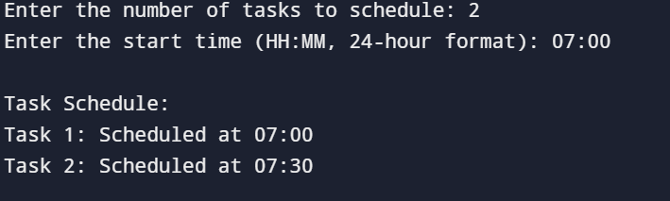
Results and Discussion (Cont..)

Slide 14
Conclusion
The Daily Task Scheduler project successfully addresses the need for effective task management, providing users with a reliable and user-friendly tool for organizing their daily activities.
By incorporating features like task creation, prioritization, deadlines, and reminders, the system helps users manage their time more efficiently and meet their goals with minimal stress.
The Java-based graphical user interface (GUI), built with Swing or JavaFX, ensures a seamless user experience, making the application accessible even to non-technical users.
The project’s data persistence mechanism, either through file handling or a database, ensures that users' task data is safely stored and easily retrievable, offering continuity across sessions.

Slide 15
Thank You
Any queries?...

